Slide 1


Restaurant management system
(With GST Billing)

Slide 2
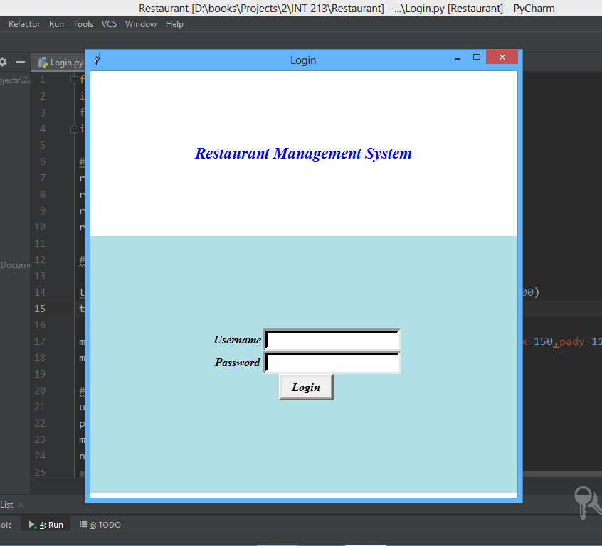

Login page
If the manager enters correct password the homepage window opens else it displays an “invalid credential” message.

Slide 3
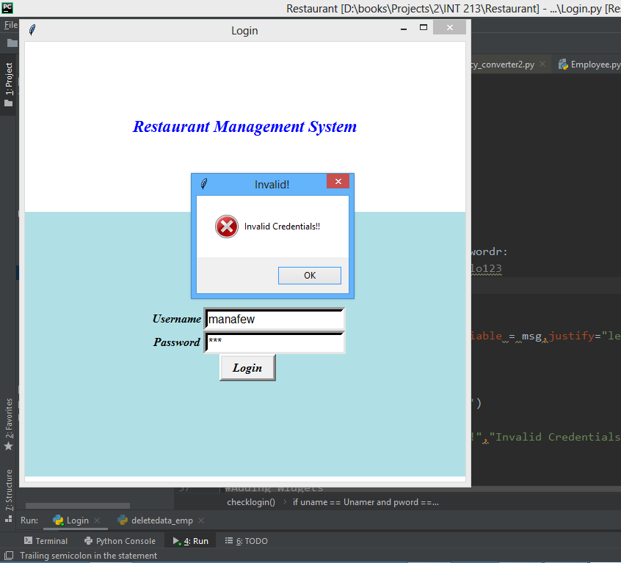
Displaying error

Slide 4
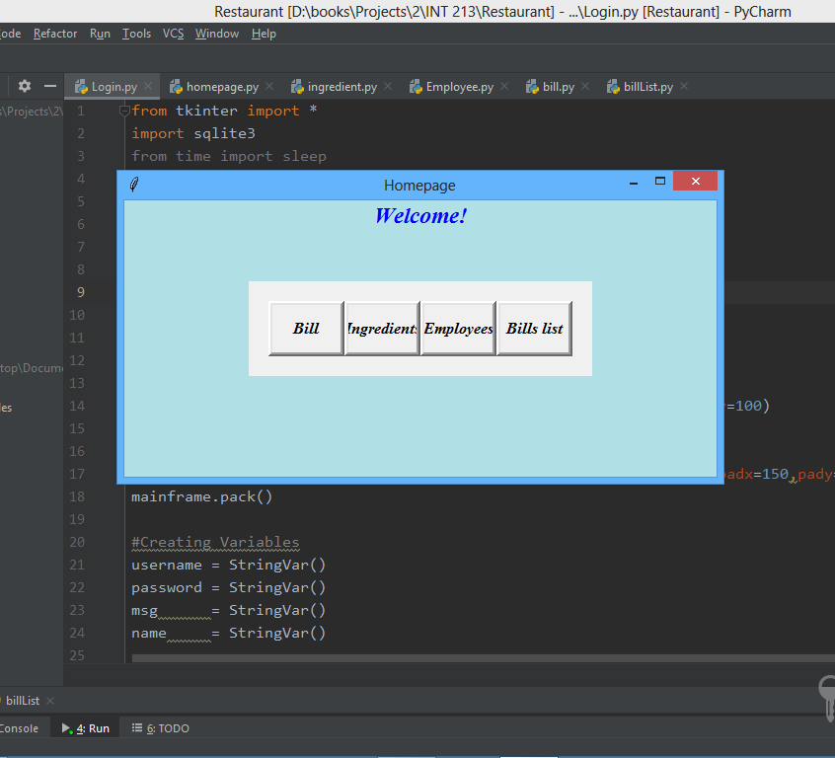
Homepage
Upon successful login the homepage appears on the screen

Slide 5
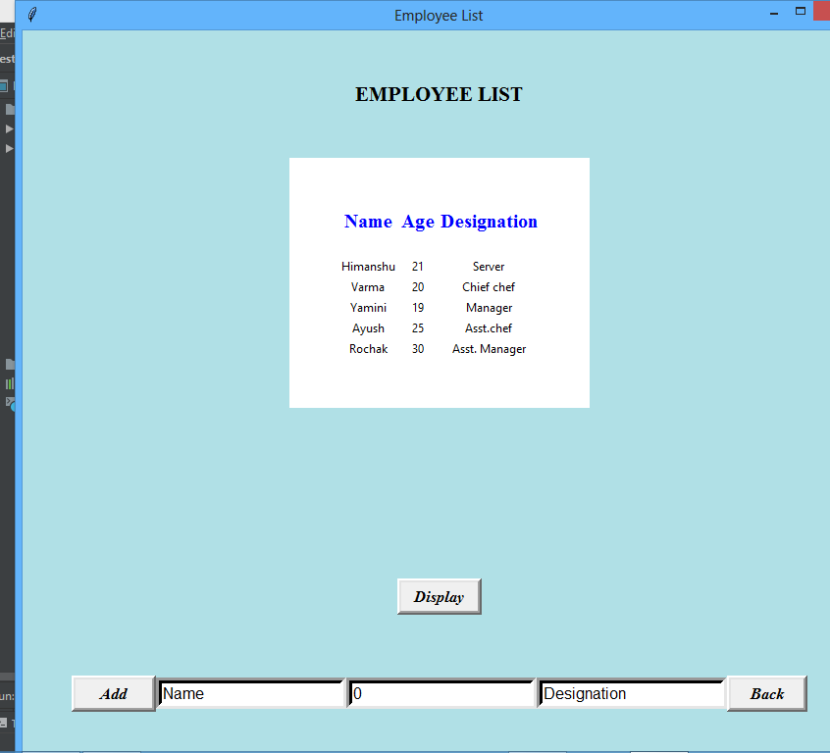
Employee List
Displays the list of the employees upon clicking the display button
We can also add the employees in the list
Back button takes us back to homepage

Slide 6


Slide 7
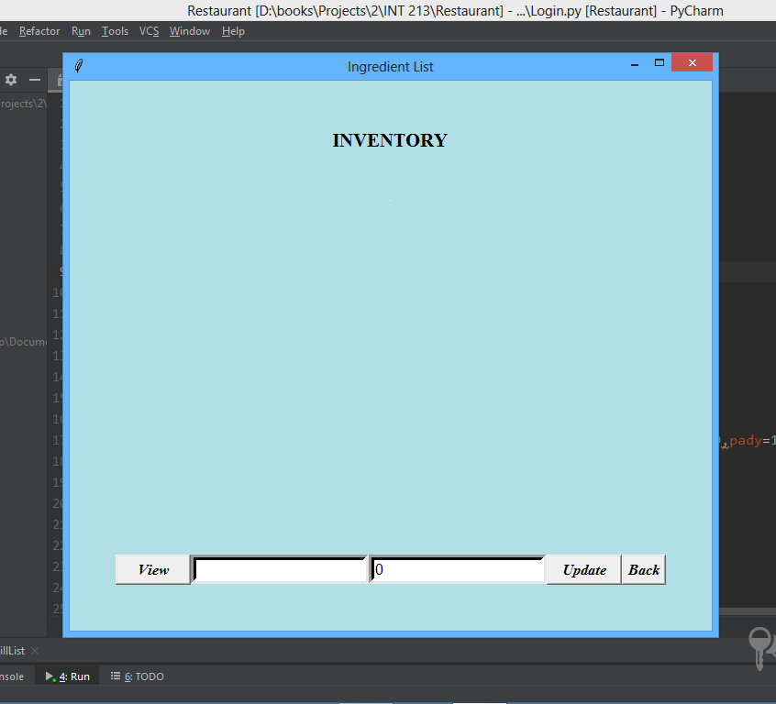
Inventory list
View button - This displays the data
Update button – Updates the data with entry field of item and quantity
Back button – Takes us back to the homepage

Slide 8
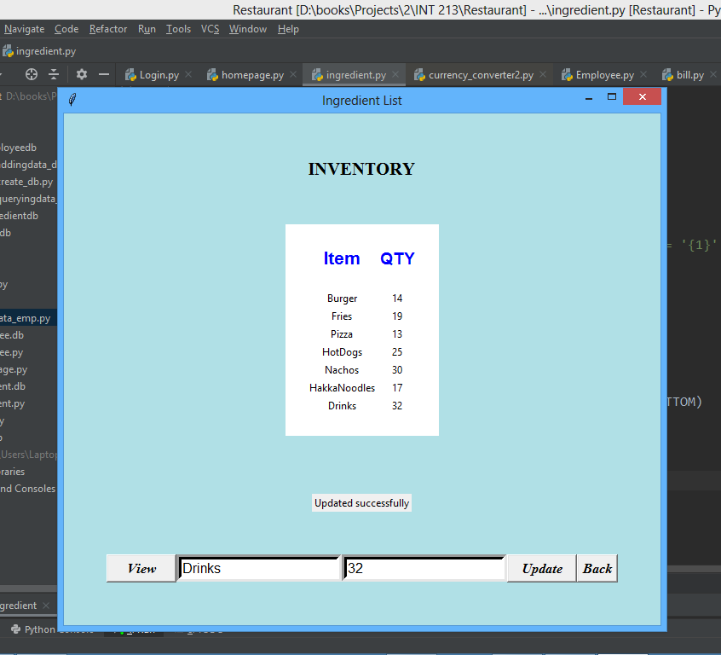

Slide 9
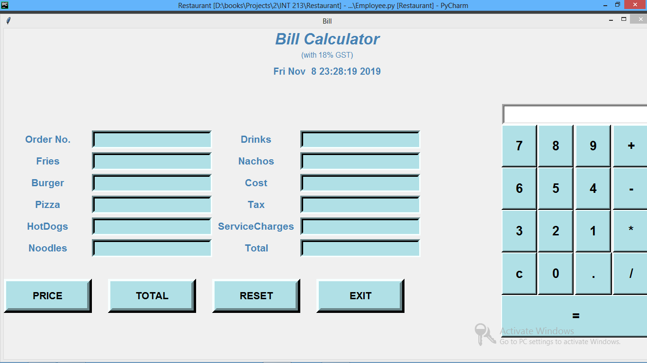
BILL calculator
This calculates the bill and it stores the bills in the database.
Price button – This displays the price list of the items available.
Total button - This calculates the total
Reset button – This sets all the entries to empty.
Exit button – Closes the window
Calculator – Used to manually calculate some basic calculations.

Slide 10
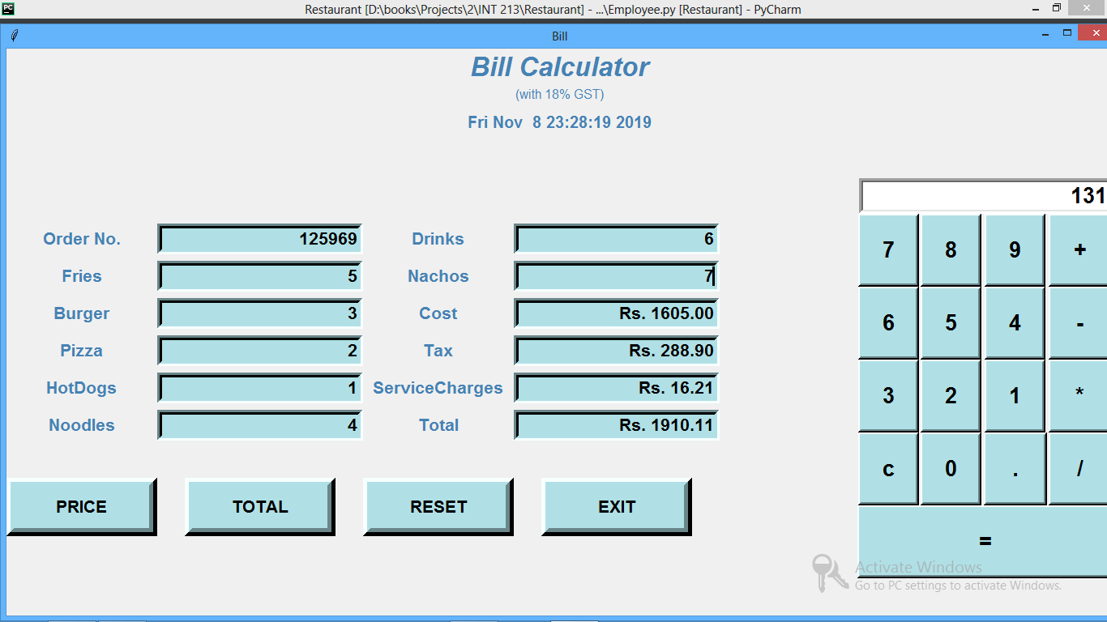

Slide 11
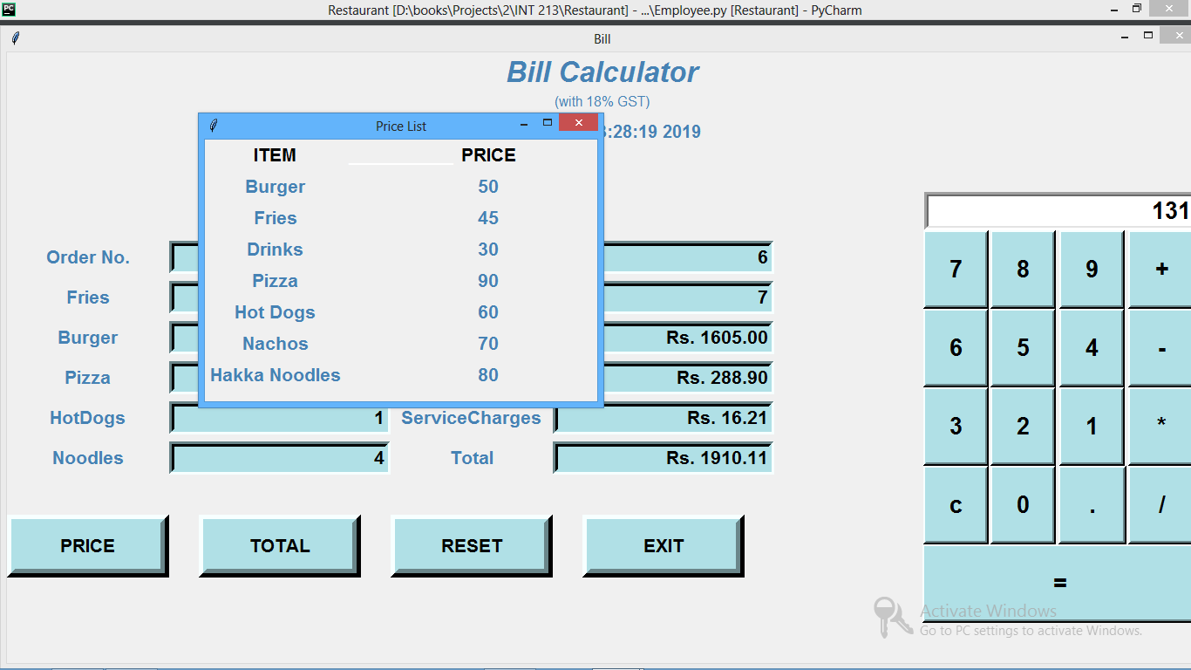

Slide 12
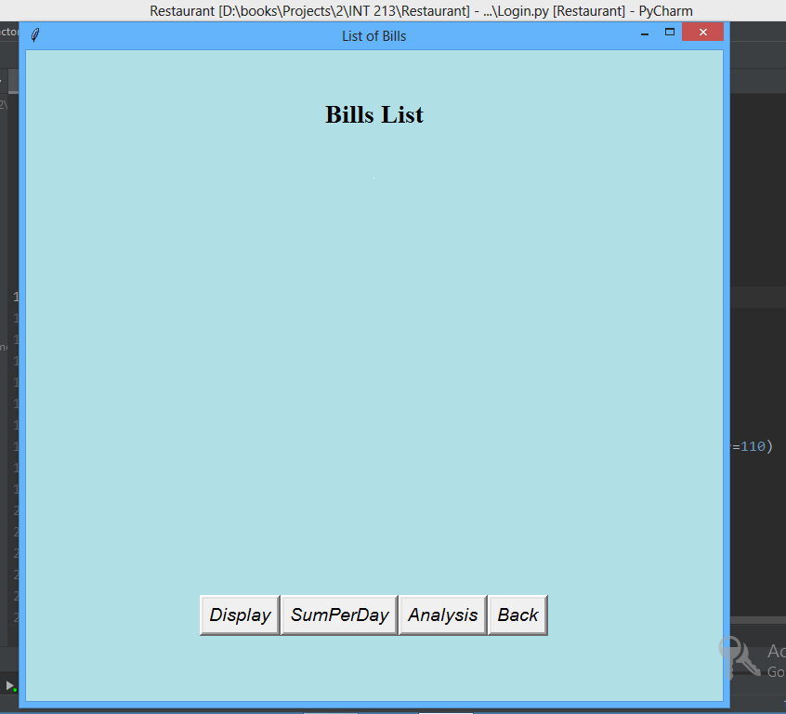
Bill list
This shows the previously stored bill which are present in the database.
Display button - This displays all the bills with order no.
Sumperday button – This displays the sum of bills per particular date
Analysis – This displays a graph between date and sum of bills
Back – Homepage

Slide 13
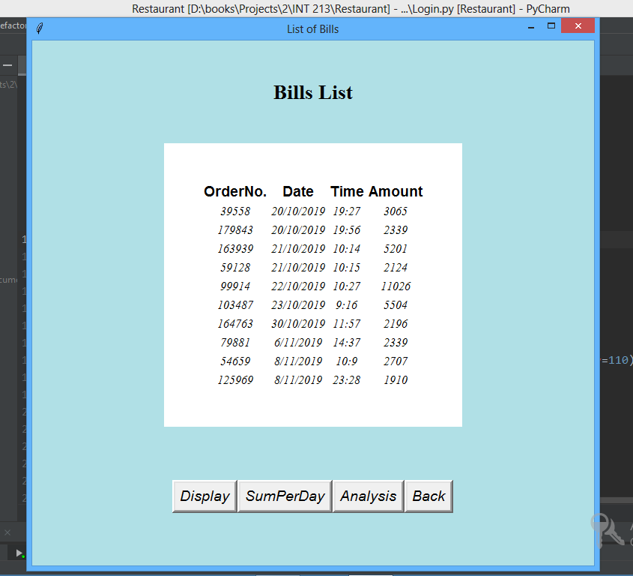
Bills

Slide 14
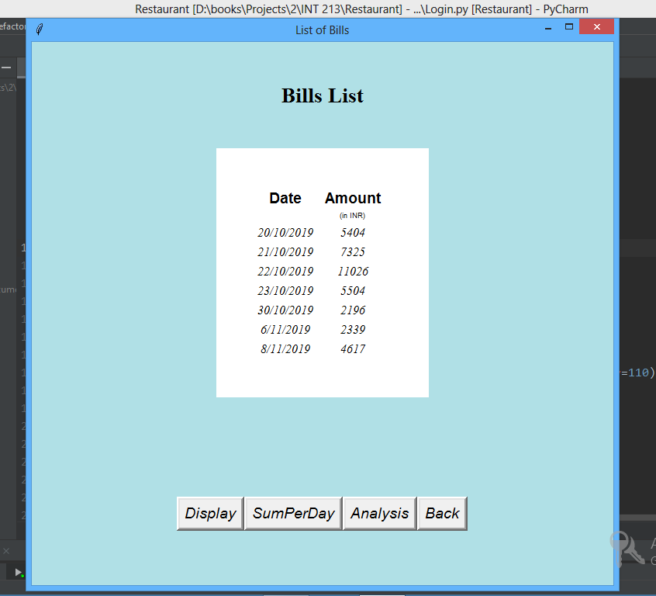
Sum of bills per day

Slide 15
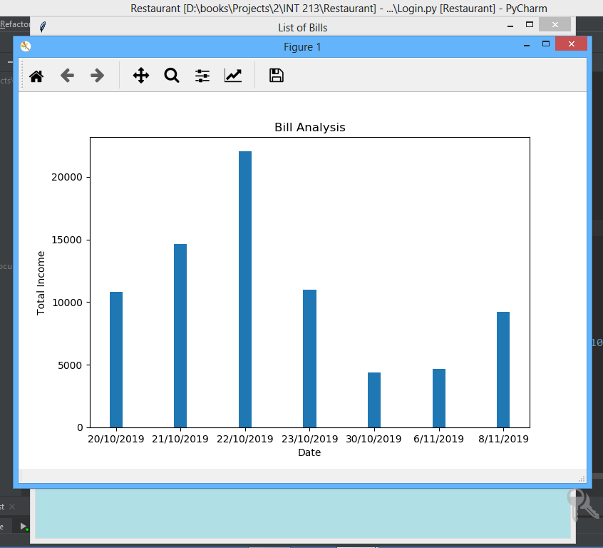
Bill analysis
We plotted the graph between total income per day and date.
We used matplotlib module.

